Slide 1

Loan Default Prediction for Loan Application
Katie Adams
DSC 680 – Capstone
Winter 2022/23

Slide 2
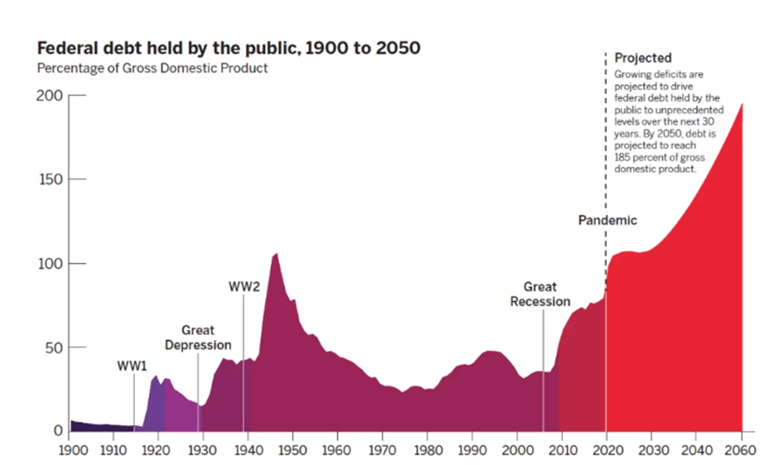
Financial Institution Loans in the United States
“Personal loan debt is higher than ever in 2022. U.S. consumers have $177.9 billion in unsecured personal loan balances (a record high), and the average balance per loan is $9,896.”
“The biggest trend overall in the personal loan industry is the overall increase in borrowing. Loan originations had plummeted during the pandemic as lenders were reluctant to approve applications. That changed last year, as there were a record 5.73 million loan originations in the fourth quarter of 2021, 9.6% more than pre-pandemic numbers in 2019.”
“The 60-day delinquency rate on personal loans is 3.25%, which is slightly below pre-pandemic levels.” (Daly, 2022)
Loan underwriters govern the loan origination process – the process of when a borrower applies for a new loan and the lender processes the loan application and provides loan approval or rejection

Slide 3
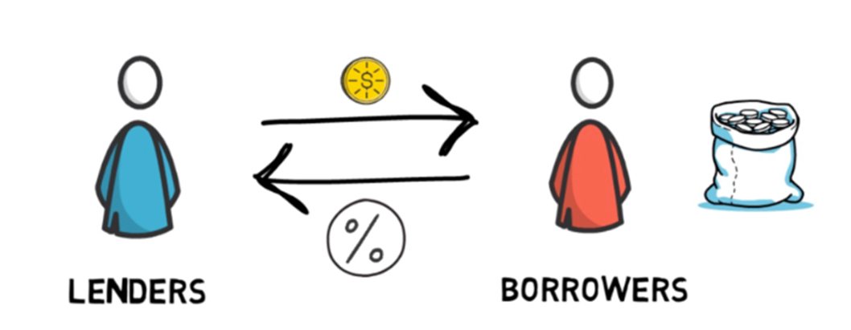
Predictive or Related Factors of Loan Defaults
Loan underwriters would be interested in understanding what factors are most predictive of loan defaults. Predicting loan defaults provides the loan underwriter with more information on if the loan application should be approved (predicted loan defaults mean loan application is rejected, no predicted loan default means loan application is approved)
Mortgage brokers would be interested in these factors to better advise loan clients on what factors will improve their loan application approval chances
Borrowers would be interested to better understand what they could do to improve their loan application approval chances

Slide 4
Dataset Features
ID: Unique identifier of the loan application (continuous numerical variable, no units)
LIMIT_BAL: Amount of the given credit (NT dollar): it includes both the individual consumer credit and his/her family (supplementary) credit (continuous numerical value in dollars)
SEX: Loan applicant gender (1=Male, 2=Female)
EDUCATION: Loan applicant level of education (1 = graduate school; 2 = university; 3 = high school; 4 = others)
MARRIAGE: Loan applicant marital status (1 = married; 2 = single; 3 = others)
AGE: Loan applicant age (continuous numerical value in years)
PAY_0-6: History of past payment (from April to September, 2005) as follows: X6 = the repayment status in September, 2005; X7 = the repayment status in August, 2005; . . .;X11 = the repayment status in April, 2005 (0 = pay duly, 1 = payment delay for one month, 2 = payment delay for two months; . . .8 = payment delay for eight months, 9 = payment delay for nine months and above)
BILL_AMT1-6: Amount of bill statement (NT dollar). X12 = amount of bill statement in September, 2005; X13 = amount of bill statement in August, 2005; . . .; X17 = amount of bill statement in April, 2005 (continuous numerical value in dollars)
PAY_AMT1-6: Amount of previous payment (NT dollar). X18 = amount paid in September, 2005; X19 = amount paid in August, 2005; . . .;X23 = amount paid in April, 2005 (continuous numerical value in dollars)
default payment next month: If the loan applicant defaulted on the payment next month (Yes = 1, No = 0)
Predictive or Related Factors of Loan Defaults
To understand what borrower/loan applicant factors are most related to or most predictive of loan defaults (single characteristics and interactions) an open-source dataset from UCI Machine Learning was used with 30,000 rows and 25 columns of US loan default data
Each dataset column represents a factor or feature that is a measurable piece of data that can be used in this analysis

Slide 5
Discovery
Most people in the dataset have a Limit Balance between 4000 and 1000 dollars, are between the ages of 25 and 45 years, do not default on their next loan payment, do pay their loan payments on time in the first month
Loan default rates are relatively the same in both men and women (however women have a slightly higher default rate as there are more females in the dataset)
Sex and Education appear to be a significant factor in predicting loan default
Correlations
The dataset loan default features most correlated to defaults are: PAY_0 followed by PAY_2-6 (History of past payment tracked the past monthly payment records)

Slide 6
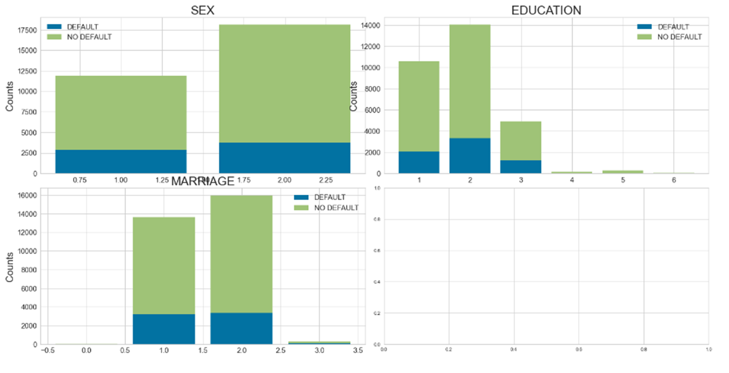
Discovery

Slide 7
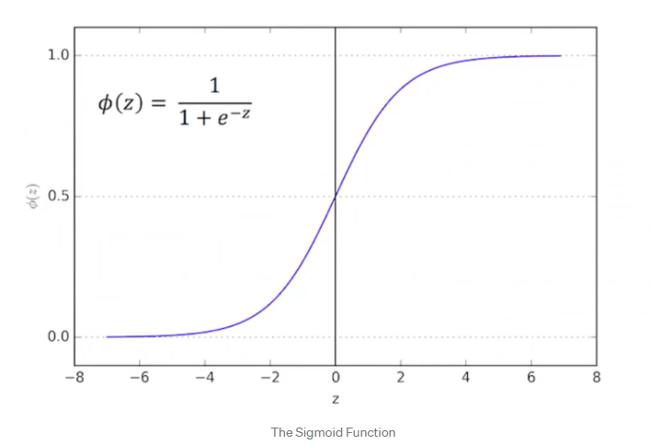
To determine which loan applicant features are most predictive of loan default, a logistic regression model was created as the prediction is either "Loan Default" or "No Loan Default" Logistic Regression Models: 2 models using a combination of all features, 5 best features from X2 and automatic weighting of the target class (default payment next month) was since there are 4 times as many subjects with no history of loan default compared to those with loan defaults
Methods

Slide 8
Accuracy: “Accuracy represents the number of correctly classified data instances over the total number of data instances” (B, H. N., 2020)
Precision: “Precision talks about how precise/accurate your model is out of those predicted positive, how many of them are actual positive.” (B, H. N., 2020)
Recall: “Recall actually calculates how many of the Actual Positives our model capture through labeling it as Positive (True Positive).” (B, H. N., 2020)
F1 Score: “F1-score is a metric which takes into account both precision and recall.” (B, H. N., 2020)
AUC Score: “"So, what area under the ROC curve describes good discrimination? Unfortunately there is no "magic" number, only general guidelines. In general, we use the following rule of thumb:
0.5 = This suggests no discrimination, so we might as well flip a coin.
0.5-0.7 = We consider this poor discrimination, not much better than a coin toss.
0.7-0.8 = Acceptable discrimination
0.8-0.9= Excellent discrimination
>0.9 = Outstanding discrimination" (Dixon, 2020)
Methods

Slide 9
Chi- Squared (X2): When two features are independent, the observed count is close to the expected count, thus we will have smaller Chi-Square value. So high Chi-Square value indicates that the hypothesis of independence is incorrect. In simple words, higher the Chi-Square value the feature is more dependent on the response and it can be selected for model training. The 5 Best Features with the highest X2 value are as follows: LIMIT_BAL PAY_AMT1 PAY_AMT2 PAY_AMT3 PAY_AMT5
Methods

Slide 10
Results
The Logistic Regression Model with automatic class balancing and all 23 Features could be selected as our model because the accuracy, precision, recall, F1 and AUC scores were all acceptable, including the F1 score for the minority class (Yes- Loan Default)
The Logistic Regression Model with automatic class balancing and the 5 best features from X2 could be selected as our model because the accuracy, precision, recall, F1 and AUC scores were all acceptable, including the F1 score for the minority class (Yes- Loan Default)
Although the Logistic Regression Models had relatively the same performance, the fact that the 5 best features from X2 model did relatively the same as all 23 features model lends itself to show that these 5 best features (LIMIT_BAL, PAY_AMT1, PAY_AMT2, PAY_AMT3, PAY_AMT5) have a bigger impact on the target variable (default payment next month) than any of the other variables combined
The Logistic Regression Model with automatic class balancing using 5 best features from X2 should be selected as our model of choice

Slide 11
Results
Model | Accuracy | F1 Score (Yes-Loan Default) | F1 Score (No-Loan Default) | AUC Score
Logistic Regression - Automatic class weighting of target variable with all 23 features | 78% | 0.522 | 0.857 | 0.77
Logistic Regression - Automatic class weighting of target variable with 5 best features using X2 | 78% | 0.526 | 0.858 | 0.75

Slide 12

Recommendations
As a recommendation, the X2 5 best features are easier to implement in a financial institution environment/setting than all 23 (i.e., it's easier to inform loan underwriters on 5 features that impact or are most related to loan defaults, rather than 23 features). The 5 best features are:
LIMIT_BAL: Amount of the given credit (NT dollar): it includes both the individual consumer credit and his/her family (supplementary) credit (continuous numerical value in dollars)
PAY_AMT1: History of past payment (April 2005)
PAY_AMT2: History of past payment (May 2005)
PAY_AMT3: History of past payment (May 2005)
PAY_AMT5: History of past payment (July 2005)

Slide 13

Recommendations
When advising loan underwriter on how to assess how risky customers would be to provide a loan to, these are the recommendations to provide:
Customers with lower limit balance and duly paid historical monthly loan payments less likely to default on their loans
These particular customers should be given a better chance of having their loan applications approved as their likelihood of defaulting on that loan is lower than that of customers who have a higher limit balance and pay their historical monthly loan payments late
Customer incentives for decreasing the risk of loan defaults and increasing their future loan application approval chances could include: free access to credit score websites (e.g. Equifax, TransUnion) to monitor their loan payments, and free access to money management sites (e.g., Mint.com)

Slide 14

Recommendations
When mortgage brokers are advising clients when applying for loans, these are the 5 recommendations to provide:
You should keep your limit balance reasonably low
You should avoid paying your monthly loan payments late
You should focus on paying your monthly loan payments on time

Slide 15

Next Steps
The logistic model has been trained and then a testing set used to obtain model accuracy, precision and F1 scores. The next step would be to do a real-life test with loan applicant data from financial institutions.
The model isn’t necessarily ready for deployment, but it is ready to be beta tested with real-life data from loan applications. This will ensure that more potential real-world scenarios that relate or do not relate to defaulting on the next loan payment are captured in the dataset
To improve the model, financial institution staff (specifically, underwriters) will also be interviewed on loan application data collection and possible methods for improvement. Examples of feedback include different data repositories, new features/measurements from loan applicants to add to the dataset (e.g., number of dependents, number of current financial accounts), possible anecdotal features that underwriters and loan officers have observed in the field

